Slide 1
EIDM processes seeking transformation for improved impacts
Date: 30 October 2024 Time: 14:00 - 15:15 SAST

Slide 2

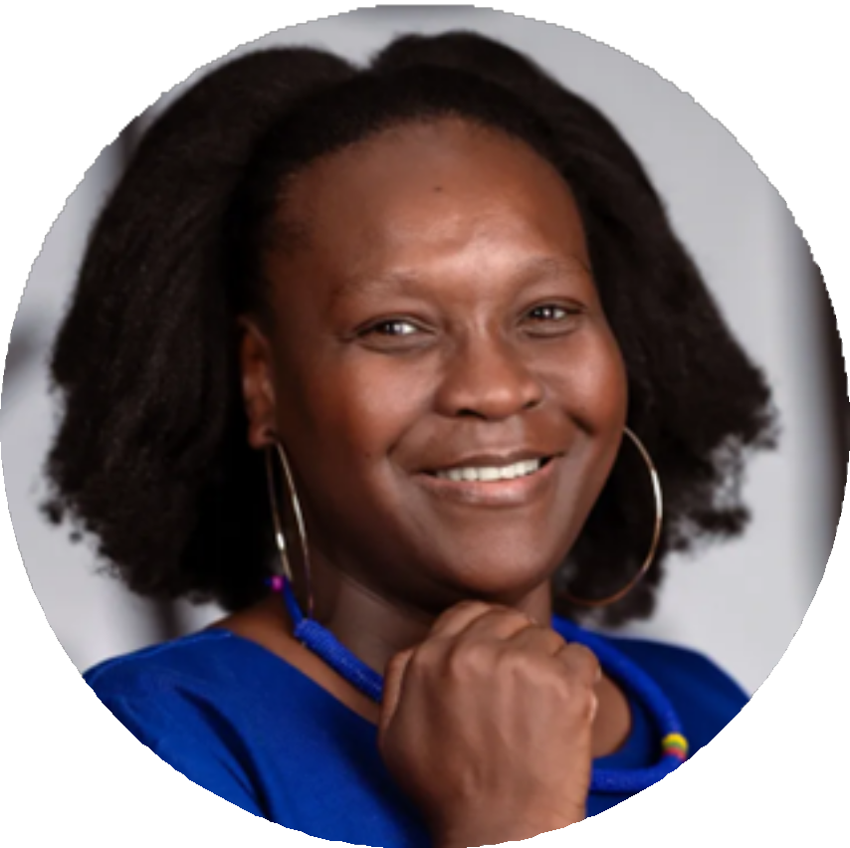

Chairperson
Siziwe Ngcwabe – Director and Co-chair, Africa Evidence Network

Slide 3


Housekeeping
We invite you to participate as much as possible! The session will be recorded.
We have cameras off to save bandwidth for us on slow connections.
Keep your mic off, unless prompted to switch on by facilitators. This is to reduce disruptive background noise in the webinar.
In case of technical problems, please write to Charity Chisoro in the chat
box.
Engage with us on the chat box during the webinar. Charity Chisoro will manage all your inputs and questions.

Slide 4


About the Manifesto
Drafted by the working group. Output of EVIDENCE2020 Online.
Declaration by all from Africa's evidence ecosystem about the kind of
capacity development we practice.
African-led approach to enhancing capacities for EIDM in Africa. Serves as a resource and inspiration to the evidence ecosystem in the continent.
Challenge mainstream views on capacity-building for EIDM in Africa.
Read it at: https://africaevidencenetwork.org/en/learning-space/file/189/

Slide 5

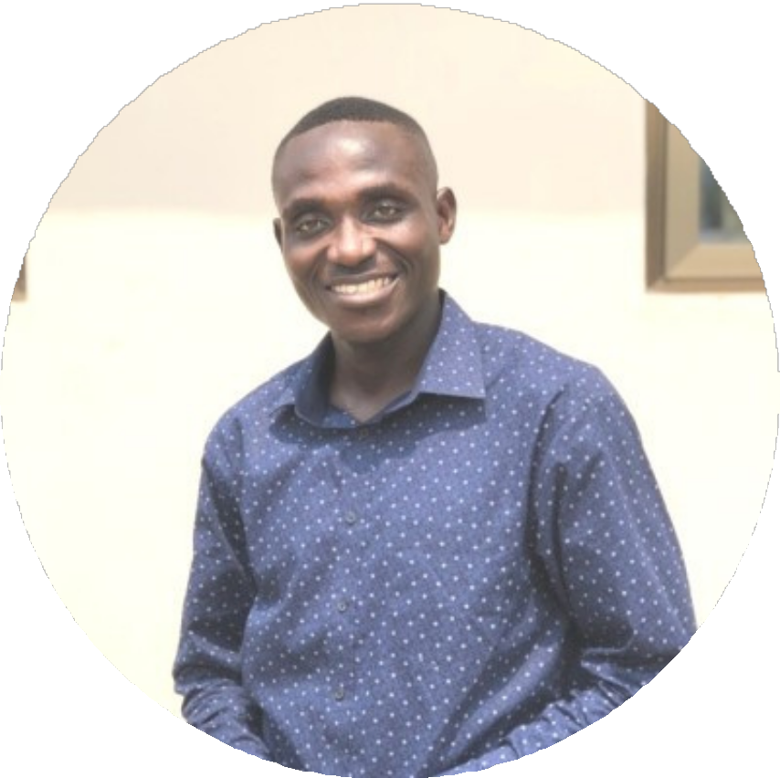
Moderator
Kirchuffs Atengble – Research team lead, PACKS Africa

Slide 6
Broad overview of the webinar
We are looking for ways to use innovative capacity-building strategies to advance EIDM throughout the continent.
Capacity strengthening entails people, institutions, and systemic level
strengthening in establishing, adapting, and maintaining sustainable EIDM capacity, as outlined in the Manifesto on Capacity Development for EIDM in Africa.
To accomplish this, it is essential to develop the abilities of both individuals and
groups to create or improve institutional structures, systems and procedures to achieve better outcomes.
Comprehending the various processes that are involved in relation to the
different actors in the evidence ecosystem is, therefore, critical.
A nuanced understanding of these processes can foster equity and inclusiveness in formulating interventions for capacity strengthening.

Slide 7
About the webinar today
The moderator will kick off the session with a broad overview of the webinar, the specific objectives for this session, and a quick run-through of how the session will run.
The objectives of the session are to explore how to streamline EIDM
processes relating to evidence producers, intermediaries and users; identify potential transformations within these processes and connect processes to impacts
Introduction of panellists and setting the scene with initial comments.
A panel discussion, with the moderator posing questions and facilitating
a discussion initially amongst panellists, and then with the audience as well. Closing: Chair

Slide 8
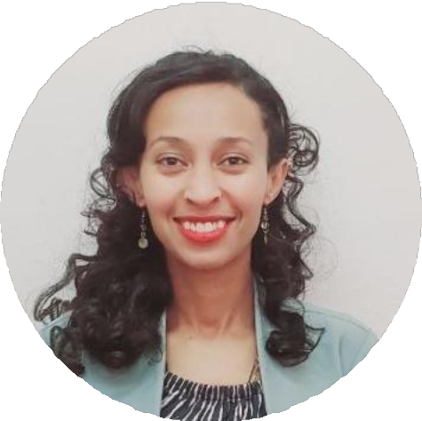
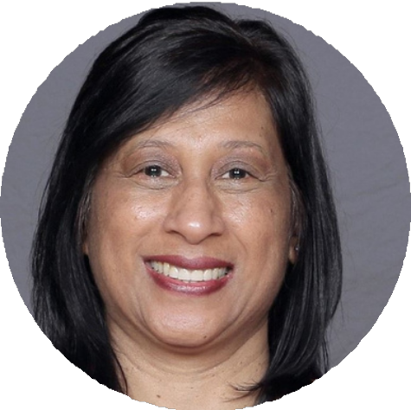
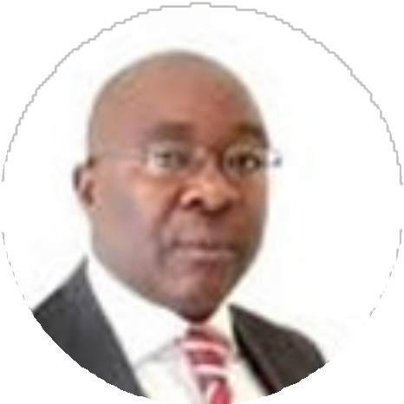
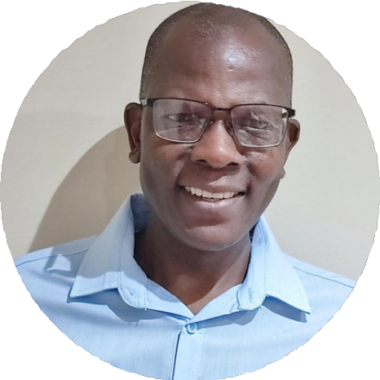

Panellists
Firmaye Bogale
Harsha Dayal
Vhumani Magezi
Ronald Munatsi
Justina Onumah

Slide 9

Closing the session
The recording for the webinar and a blog on this webinar will be published to ensure we continue engagements asynchronous on capacity development for evidence use - via LinkedIn.
Follower the AEN on LinkedIn: https://www.linkedin.com/company/africa-evidence-network/

Slide 10




Thank you!
Hosted by
Questions?
Africa Evidence Network
www.africaevidencenetwork.org
@Africa_Evidence
This work is licensed under CC BY-SA 2.5 ZA. Full license details here: https://creativecommons.org/licenses/by-sa/2.5/za/

